Slide 1
Deep Learning on Graphs II: Advanced Topics, Lecture 2
Michael Kenning, Stavros Georgousis

Slide 2
Outline
Stavros’ lecture:
Temporal graphs, and
Miscellaneous problems.
Michael’s lecture:
Edge attributes and signals, and
Graph estimation.

Slide 3







What Are Edge Signals/Attributes?
Signals structured on vertices.
Signals/attributes structured on the graph’s edges.

Slide 4

Example: Molecules and Molecular Interactions
Vertices as atoms (the entities), edges as chemical bonds (the interactions/relations).
Represent information on vertices:
Valence, atomic number, mass, etc.
How and where do we represent the following information?
Bonding distance (second-order interaction);
Bonding angles (third-order interaction);
Intramolecular bonding (second-order interaction)
Secondary structures in proteins (high-order interaction).

Slide 5
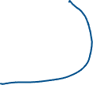

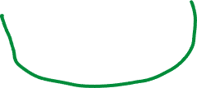







Edge Features: Not as Straightforward
Identified three situations where there are edge signals/attributes:
Edge attributes that specify the interaction of the adjacent vertices.
e.g. knowledge graphs, or valence bonding, intra- and inter-molecular bonding, etc.
The edge attributes here may be discrete.

Slide 6



Example: Edge-conditioned Convolution (Simonovsky and Komodakis, 2017)
The edges are mapped to a label:
The label is used to index a weight matrix:
The neighbours’ signals are projected through the matrix:

Slide 7




Edge Features: Not as Straightforward
Identified three situations where there are edge signals/attributes:
Edge attributes that specify the interaction of the adjacent vertices.
e.g. knowledge graphs, or valence bonding, intra- and inter-molecular bonding, etc.
Edge signals integrated into learning on the vertices
e.g. distances/angles of chemical bonding or intramolecular bonding
Must be continuous.

Slide 8
Example: Weaving (Kearnes et al., 2016)
One unit for the vertices/atoms:
One unit for the links/pairs of atoms:
Another two units that merge the output of the two:

Slide 9










Edge Features: Not as Straightforward
Identified three situations where there are edge signals/attributes:
Edge attributes that specify the interaction of the adjacent vertices.
e.g. knowledge graphs, or valence bonding, intra- and inter-molecular bonding, etc.
Edge signals integrated into learning on the vertices
e.g. distances/angles of chemical bonding or intramolecular bonding
Learning on the edges themselves
e.g. regressing on some property
(vertices may have signals)

Slide 10

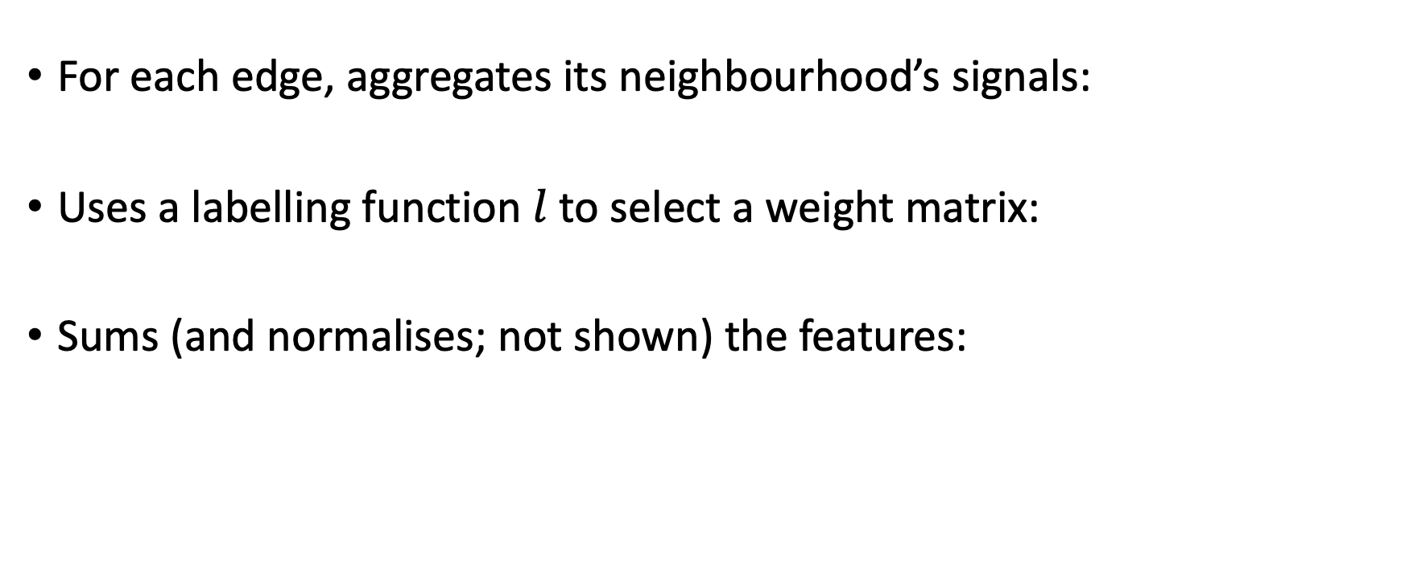
Example: Graph edge convolutional network (Zhang et al., 2020)
For each edge, aggregates its neighbourhood’s signals:
Uses a labelling function $l$ to select a weight matrix:
Sums (and normalises; not shown) the features:

Slide 11
Edge Signals and Attributes: Lacunae
The particular approach is ad hoc:
No comparative analysis of the techniques of including edge signals in convolution.
None considers a situation where the signals exist on the edges alone:
What does this mean? (See the next slide.)
What about higher-order structures on the graph?
Not just bonding distances, but bonding angles.
How to represent higher-order interactions? (See the next slide, too.)

Slide 12
Higher-order Interactions: Linegraphs
One solution is to model higher-order interactions with linegraphs.
A linegraph represents the second-order structure of a graph.
The linegraph of a linegraph represents the third-order structure of a graph, et cetera ad nauseum.
How to combine the information at each layer?

Slide 13



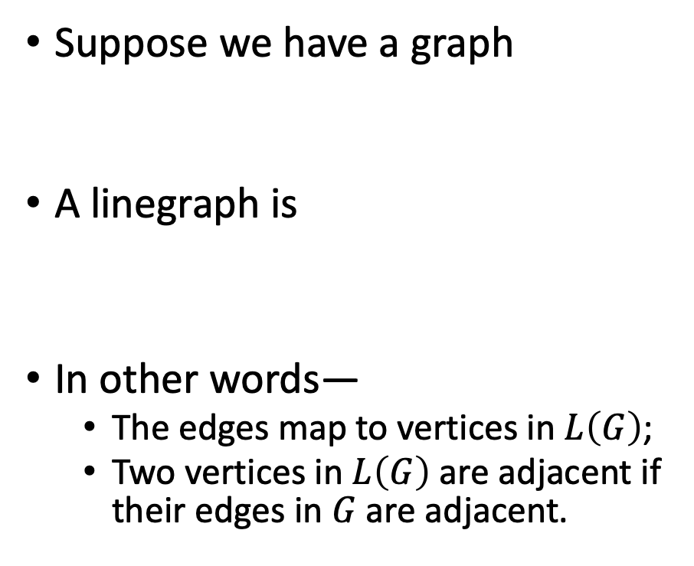


Linegraphs
Suppose we have a graph
A linegraph is
In other words—
The edges map to vertices in $L\left(G\right)$;
Two vertices in $L\left(G\right)$ are adjacent if their edges in $G$are adjacent.

Slide 14









Example: Datacentres
Link failures, where the signals exist only on the edges.
Local effects, so structure is important.
Represented well as a (line-)graph.
Convolution works as on a normal graph.

Slide 15






Graph Estimation
Can one learn the graph structure present in data?
Various terms in the literature; no unifying framework.
Neural relational inference
Graph estimation
Graph generation
Structure learning
A question of missing structure.
Some applications:
Learning the structure of an EEG scan, drug discovery, extrapolating the interactions in physical systems

Slide 16
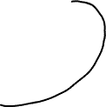


How to Learn the Structure?
To what real things does the structure correspond?
A graph describes—
the relations/interactions between
a set of discrete entities.
Relations predicated on entities.
How to discover entities?
If we don’t know the entities—
Ontological and epistemological question, so not exactly easy.
As a shortcut, side-step the philosophical issue: take an arbitrary partitioning.
If we know the entities, the problem is more tractable.

Slide 17
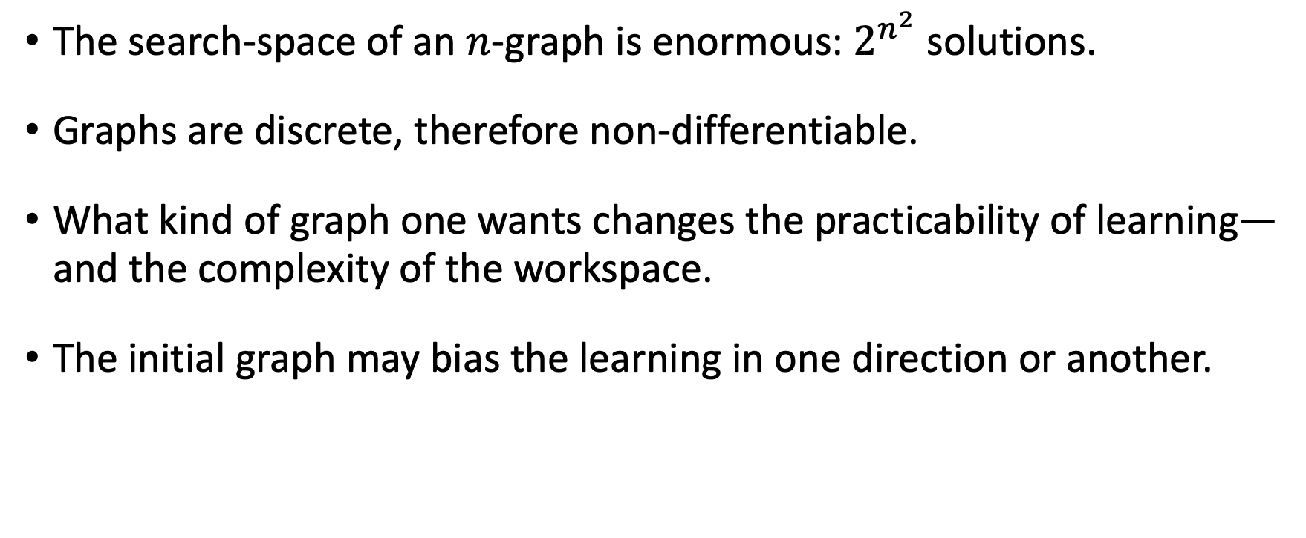
Learning the Relations of Entities: Challenges
The search-space of an $n$-graph is enormous: $2^{n^{2}}$ solutions.
Graphs are discrete, therefore non-differentiable.
What kind of graph one wants changes the practicability of learning—and the complexity of the workspace.
The initial graph may bias the learning in one direction or another.

Slide 18

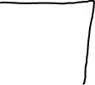
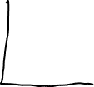


Learning the Relations of Entities: Solutions
Four ways identified in the literature:
Continuous relaxation: learn the entries of the weight matrix end-to-end.

Slide 19

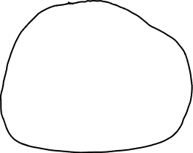





Learning the Relations of Entities: Solutions
Four ways identified in the literature:
Continuous relaxation: learn the entries of the weight matrix end-to-end.
Learn the interaction function.

Slide 20




Learning the Relations of Entities: Solutions
Four ways identified in the literature:
Continuous relaxation: learn the entries of the weight matrix end-to-end.
Learn the interaction function.
Generate edges sequentially.

Slide 21









Learning the Relations of Entities: Solutions
Four ways identified in the literature:
Continuous relaxation: learn the entries of the weight matrix end-to-end.
Learn the interaction function.
Generate edges sequentially.
Generate whole graphs simultaneously.

Slide 22
References
S. Kearnes, K. McCloskey, M. Berndl, V. Pande and P. Riley, ‘Molecular graph convolutions: Moving beyond fingerprints’, J. Comput.-Aided Mol. Des., vol. 30, no. 8, pp. 595-608, Aug. 2016.
M. Simonovsky and N. Komodakis, ‘Dynamic edge-conditioned filters in convolutional neural networks on graphs’, Proc. IEEE Conf. Comput. Vis. Pattern Recognit., pp. 3693-3702, Dec. 2017.
X. Zhang, C. Xu, X. Tian and D. Tao, ‘Graph edge convolutional neural networks for skeleton-based action recognition’, IEEE Trans. Neural Netw. Learn. Syst., vol. 31, no. 8, pp. 3047-3060, Aug. 2020.

Slide 23



